Slide 1
CS544 Introduction to Network Science Introduction
Most slides adapted from Konstantinos Pelechrinis course on Network Science & Analysis, University of Pittsburgh

Slide 2
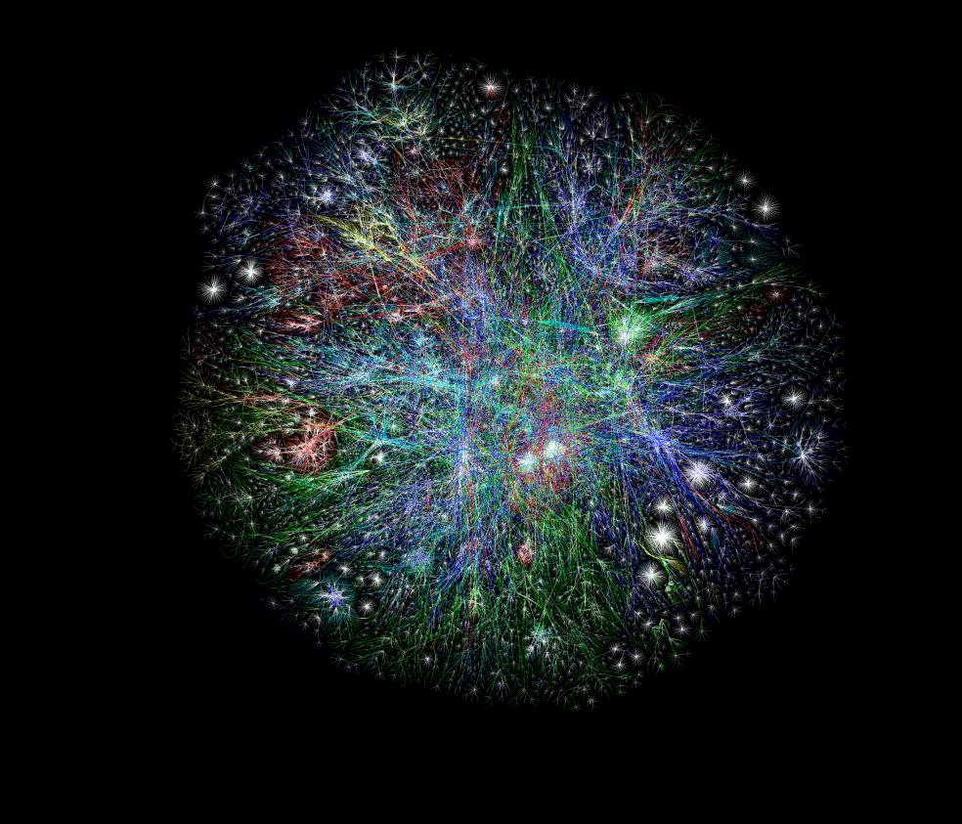
The Internet

Slide 3
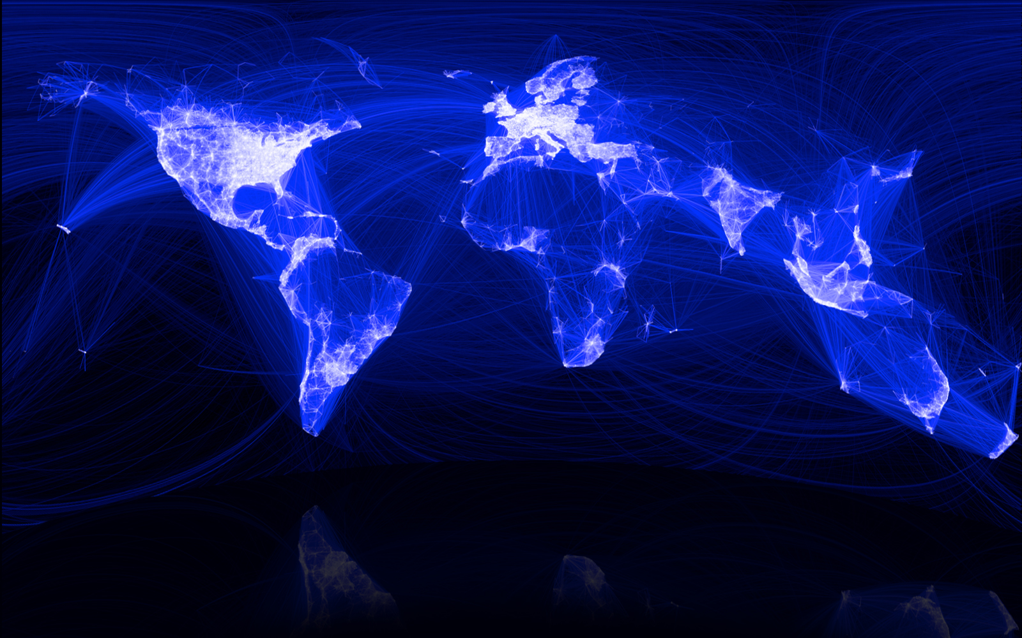
Social Networks
Keith Shepherd's "Sunday Best”. http://baseballart.com/2010/07/shades-of-greatness-a-story-that-needed-to-be-told/

Slide 4
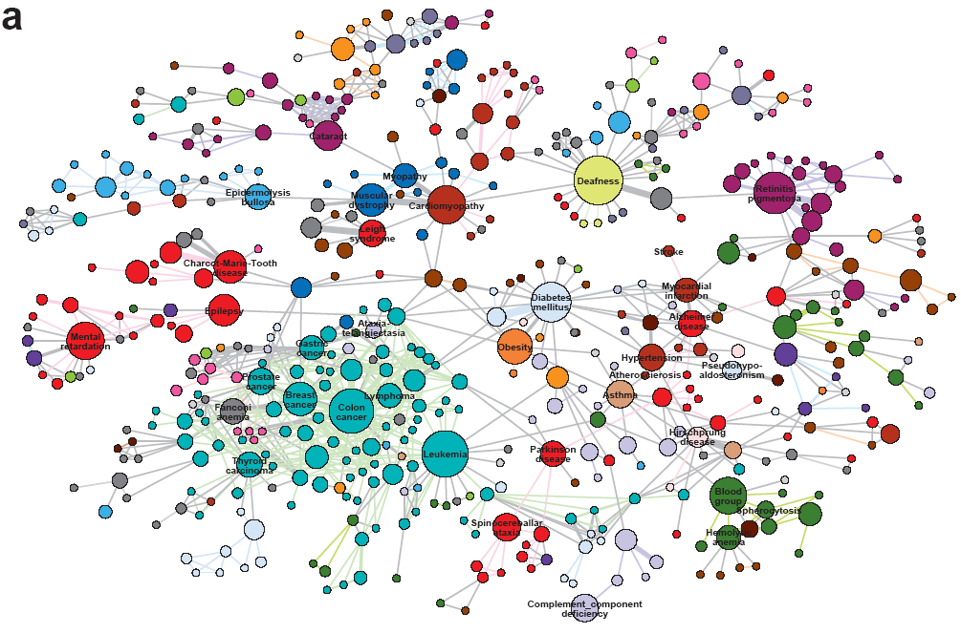
Human Disease Network

Slide 5
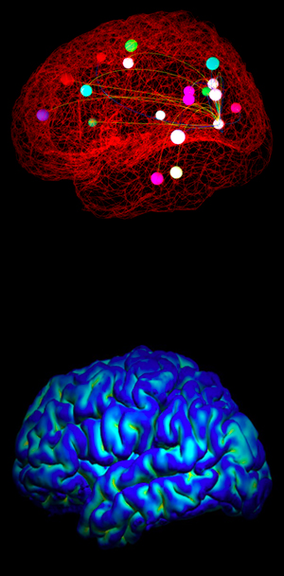
Neuro Networks

Slide 6
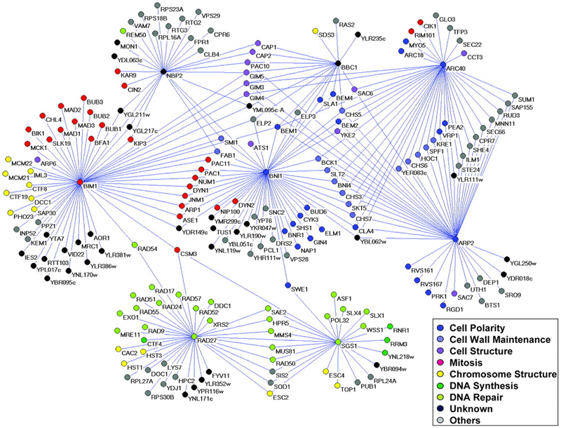
Genetic interaction network

Slide 7
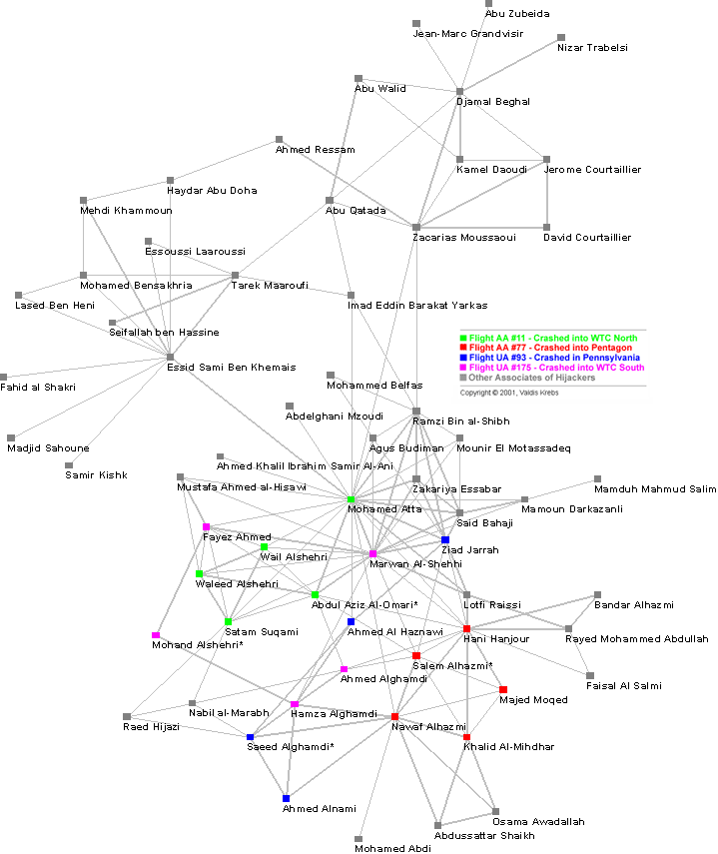

Slide 8
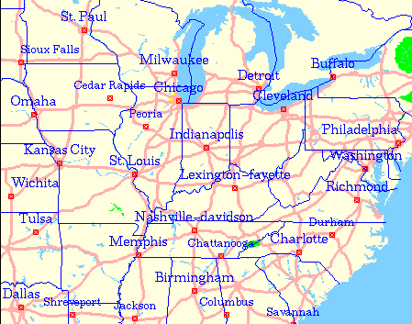
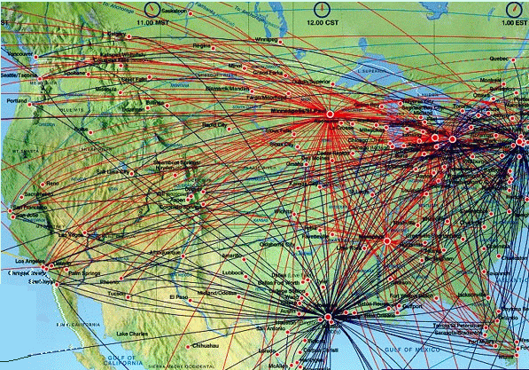
Road and Airlines Network

Slide 9
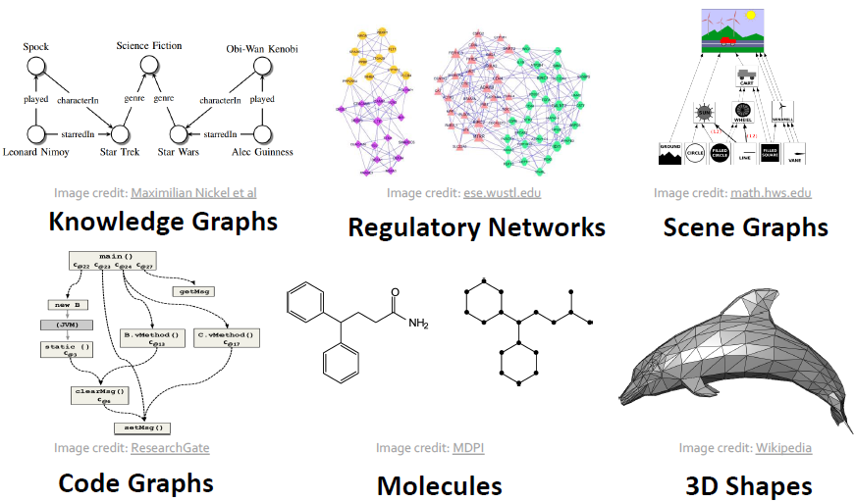
Other Data as Graphs
Source: CS224W Stanford

Slide 10
Why Networks?
Nothing happens in isolation: “everything is connected, caused by, and interacting with a huge number of other pieces of a complex universal puzzle” (AL Barabasi, “Linked”)
The power of the network is in the links
However, most people don’t see the links till they are exposed to them

Slide 11
Why Network Science?
Study of the structural evolution of large networks
It studies networks holistically
Modeling phenomena around us using networks can be done in multiple ways and at different levels/depths
Macroscopic World
Contains the things that we can see with our eyes
In language world, grammar rules and vocabularies
Microscopic World
Contains the building blocks of matters like atoms, molecules etc.
In language world, utterances (syllables, phonemes, graphemes)
Mesoscopic World
An intermediate between the macroscopic and microscopic level
In language world, linguistic entities like letters, words and phrases

Slide 12
Why Network Science?
Networks have shifted from simple and small to complex and extremely large (data explosion)
Network modeling transitioned from static graphs to dynamic graphs
Network nodes (objects) to be studied transitioned from one type to a variety of data types (multimodal data)

Slide 13
Books
Main text book
Will Hamilton, “Graph Representation Learning”
M.J.E. Newman, “Networks: An Introduction”, Oxford University Press (2010)
Other possible references
D. Easley and J. Kleinberg, “Networks, Crowds and Markets: Reasoning About a Highly Interconnected World”, Cambridge University Press (2010)
T.G. Lewis, “Network Science: Theory and Applications”, Wiley (2009)
D.J. Watts, “Six Degrees: The Science of a Connected Age”, W.W. Norton & Company (2003)
Research papers (pointers will be provided)

Slide 14
Assignments and codes
Codes will be in Python
Libraries
NetworkX
PyTorch Geometric (PyG)
DeepSNAP
GraphGym
SNAP.py

Slide 15
Mathematics of Networks

Slide 16
The representation of networks
The network consists of entities connected with each other
The structure of these connections are represented through graphs
A graph is represented by two sets
A vertex set V of the entities participating in the network. In the rest of the slides typically, n will be the number of vertices
Also called node or actor set
An edge set E of the connections between vertices. In the rest of the slides typically, m will be the number of edges
Also called link or tie set

Slide 17
Graph terminology
A graph whose vertices are connected by at most one link is called simple network or simple graph
Most of the graphs we will examine will be simple
When two nodes connect with more than one edge, we refer to all those edges collectively as multiedge
The corresponding graph is called multigraph
Depending on the type of connection a node might be connected to itself
Self-edges or self-loops

Slide 18
Example

Slide 19
The adjacency matrix
If we label the nodes with IDs 1, 2, … n we can denote each edge as a pair (i,j)
This is an edge list specification
Good for storing and processing networks in computers, but not for mathematical development
The adjacency matrix A of a simple graph is a matrix with elements A_{ij} such that:

Slide 20
Example

Slide 21
Observations
For the (typical) case of no self-loops, the diagonal of the matrix is all 0
For undirected networks, since the existence of edge (i,j) assumes the existence of the edge (j,i), matrix A is symmetric
If node i has a self edge then we set A_{ii}=2 (why?)
Multiedges are represented by setting the corresponding entry equal to the number of distinct edges

Slide 22
Weighted networks
Some relations are not simple on/off (1/0) relations
In a weighted network links can have weights
The corresponding adjacency matrix entry is equal to the weight
Weights can represent the frequency of contacts between the actors, the capacity of a channel connecting two routers etc.
When weights are integer it might be convenient to think of the weight as multiedges
Notes:
Weights can be also negative or we can even have weights at the vertices or even a set of attributes in a vector…

Slide 23
Directed networks
In some phenomena the direction of the underlying relation between two nodes matters → relations are not reciprocal
E.g., twitter connections, world wide web links, paper citations etc.
These relations are captured through directed networks/graphs
The adjacency matrix of a directed graph (or a digraph) is given by:
A is in general not symmetric
Self edges are
represented by setting A_{ii}=1

Slide 24
Example

Slide 25
Co-citation coupling
The co-citation of two edges i and j in a directed network is the number of nodes that have outgoing edges pointing to both nodes i and j
So in order for node k to contribute to the co-citation of i and j, the following needs to be true: A_{ik}A_{jk}=1
Hence the co-citation of nodes i and j is:
The nxn adjacency matrix of the corresponding co-citation network is:

Slide 26
Co-citation coupling
The non-diagonal elements can be larger than 1
Either we consider it as a weighted undirected graph or we map every non-diagonal entry greater than 1 to 1
The diagonal elements of C can be non zero
Since A_{ik}=0 or A_{ik}=1 (assuming a simple graph – no multiedges)
C_{ii} provides the number of nodes that point to node i
In constructing the co-citation network we set by definition all the diagonal elements to zero!

Slide 27
Bibliographic coupling
The bibliographic coupling of two edges i and j in a directed network is the number of nodes that they both point to
So in order for node k to contribute to the bibliographic coupling of i and j, the following needs to be true: A_{ki}A_{kj}=1
Hence the bibliographic coupling of nodes i and j is:
The nxn adjacency matrix of the corresponding bibliographic coupling network is:

Slide 28
Bibliographic coupling
The diagonal elements of B can be non zero
Since A_{ki}=0 or A_{ki}=1 (assuming a simple graph – no multiedges)
B_{ii} provides the number of nodes that node i points to
Again when considering the bibliographic coupling network, we set by definition all the diagonal elements to zero!
The off diagonal elements of B can again be greater than 0 and hence, we can define a weighted undirected network
We can also map any positive off diagonal element to 1

Slide 29
Notes on coupling
While both coupling methods are similar they can give completely different structures
Co-citation is heavily based on incoming edges, while bibliographic coupling on outgoing edges
They can be used for vertex similarity
E.g., the highest the co-citation of two papers in a paper citation network, the more possible is that these papers deal with similar topics
While these coupling methods help us convert an directed network to undirected, we lose some structural information during this transformation

Slide 30
Problem 1
Consider certain papers and the references that they cite
1 →{2,4,5}
2 → {3,4,5}
3 →{4}
4 →{}
Which of these papers do you expect to be likely of similar topic?

Slide 31
Problem 2
Consider a product website that maintains a purchase profile of the users over a time period T. A snap shot of the same for 4 users are as follows:
A → {1,2,3}
B → {1,3}
C → {1,2, 3, 4}
D →{ 3,4}
If A purchases an unknown product (say 5), can you say which other user will most likely purchase the same product?

Slide 32
Acyclic directed networks
A cycle in a directed network is a closed loop of edges with the arrows on each of the edges pointing the same way around the loop
Networks without cycles are called acyclic, while those with cycles are called cyclic
Self edges also count as cycles
An acyclic network can be drawn with all edges pointing downward (not necessarily unique drawing)
Notes:
A classic acyclic is that of citations → since you cite papers written in previous times all edges point backwards.
Sketch proof of the “theorem”: 1) argue that an acyclic network should have a vertex with no outgoing edges, 2) then by drawing first the vertices that have no outgoing edges and removing the incoming edges to them we have a recursive way to draw the acyclic directed network in this way.

Slide 33
Determining if a network is acyclic
A simple algorithm for determining whether a network is acyclic is:
Find a vertex with no outgoing edges (step 1)
If no such vertex exists, the network is cyclic. Otherwise, if such a vertex does exist, remove it and all its incoming edges from the network (step 2)
If all vertices have been removed, the network is acyclic. Otherwise go back to step 1

Slide 34
Adjacency matrix of an acyclic network
If we construct an ordering of the vertices of an acyclic graph as per the previous algorithm, there can be an edge from vertex i to vertex j only if j > i
Adjacency matrix is triangular (only the elements above the diagonal have non zero entries)
More precisely, since the acyclic graph does not have self loops, the diagonal elements are zero → strictly triangular matrix
All of the eigenvalues of an adjacency matrix are zero if and only if the network is acyclic
Notes:
Prove the theorem
If the network is acyclic you can have an ordering of the vertices so that you have a strictly triangular matrix. Since, the diagonal elements are the eigenvalues of a triangular matrix it is proven
← You need to set up the fact that the number of cycles of size r in a network is given by the sum of the r-th power of the eigenvalues.

Slide 35
Bipartite networks
In bipartite networks (aka two-mode networks) there are two kinds of vertices
One type represents that original vertices (e.g., people) and the other represents the groups – or affiliations or foci – that the first type of vertices belong to (e.g., company)
The edges of a bipartite network run only between nodes of different type
A bipartite network is defined by the incidence matrix B. If there are n number of actors and g number of groups:

Slide 36
One-mode projections
We can use the bipartite network to infer connections between nodes of the same type
Projection on the actors → n-vertex network, where nodes are the actors of the original bipartite graph and an edge between two actors exists if they participate to at least one common group
Projection on the groups → g-vertex network, where nodes are the groups of the original bipartite graph and an edge between two groups exists if they include at least one common actor
One mode projections discard a lot of the information present in the structure of the original bipartite graph
Notes:
E.g., no information about the actual number of common groups two actors share etc.
Some improvement by adding weights at the projections.

Slide 37
Projections

Slide 38
Mathematics of actors one-mode projection
Two actors i and j belong to group k iff B_{ki}B_{kj}=1
The total number of groups P_{ij} that i and j belong is given by:
The nxn matrix P=B^{T}B is similar to the adjacency matrix for the weighted one-mode projection onto the n vertices (actors)
Why only similar and not the same?
Notes:
P_ii is not zero necessarily → It gives the number of groups that node i belongs to
Similar projection of groups (gxg matrix)

Slide 39
Trees
Connected, undirected network with no closed loops
They are usually drawn in a rooted manner
A root node at the top and a branching structure going down
Vertices at the bottom of the tree, connected only to one other vertex are called leaves

Slide 40
Trees
Since there are no closed loops there is exactly one path from every vertex to any other
This property is important because it makes some calculations particularly simple
A tree with n vertices has exactly n-1 edges
Reverse is also true!
Notes:
* First one is true since if there were two paths p1 and p2 between A and B, one could use p1 to go from A to B and p2 to return back so there would be a loop between A and B (atopo)

Slide 41
Degree
The degree k_{i} of a vertex i in a graph is the number of edges connected to it
For undirected graphs we have:
And the number of edges of a graph is given by:
Mean degree c of a vertex in an undirected graph is:
Notes:
Graphs where all nodes have the same degree are called regular (k-regular).

Slide 42
Connectance
The maximum number of possible edges in a simple graph is
Connectance or density ρ of a graph is the fraction of these edges that are actually present:
A network for which the density ρ tends to a (positive) constant as n→∞ is called dense
A network for which the density ρ tends to zero as n→∞ is called sparse
This basically means that in a sparse network c tends to a constant when n increases arbitrarily
Notes:
Is this a useful definition for all cases ? Think of networks that do not change size (so in reality you cannot take n to infinity). For networks though that change size over time, we can see the evolution of density and predict if they are dense or sparse.
Or there might be independent reasons that makes us believe a network is dense or sparse (think of the friendship network – the fact that more people are born it does not mean we will have more friends – friendship relations are associated with the cost to create and maintain the links)

Slide 43
Degrees in directed networks
In a directed network each vertex is associated with two degrees
In-degree is the number of incoming edges to a vertex
Out-degree is the number of outgoing edges from a vertex
The total number of edges in a directed network is:
Thus, mean in (c_{in}) and out (c_{out}) degrees are equal

Slide 44
Walks
A sequence of vertices such that every consecutive pair of vertices in the sequence is connected by an edge in the network
For directed graphs the edges traversed from the path needs to be traversed in the correct direction
Walks that do not intersect with themselves are called self-avoiding paths
Length of a walk is the number of edges traversed along the walk
When a walk traverses the same edge e two times, e is counted twice

Slide 45
Walks in undirected networks
The product A_{ik}A_{kj} is 1 iff there is a path between i and j through k (a path of length 2)
Hence, if we want to find how many length 2 paths between i and j exist:
This can easily be generalized to:
[A^{r}]_{ii} gives the number of length r paths that originate and end at node i (cycles)
Hence if we want to find the number L_{r} of length r cycles in a graph

Slide 46
Walks in undirected networks
A is symmetric → has n real, non-negative eigenvalues
A = UKU^{T}
U orthogonal matrix of eigenvectors
K diagonal matrix with eigenvalues
κ_{i} is the i-th eigenvalue of matrix A
Notes:
Trace is invariant under cyclic permutations

Slide 47
Paths in directed networks
The adjacency matrix of a directed network is in general non symmetric and hence not diagonalizable
We will use the Schur decomposition
A=QTQ^{T}
Q is orthogonal
T is upper triangular
Its diagonal elements are its eigenvalues
They are equal with those of A (why?)
Notes:
Assume x an eigenvector of A with eigenvalue of k. Then Ax=QTQ^Tx = kx → TQ^Tx=kQ^Tx (multiply from left and Q orthogonal) → so Q^Tx is an eigenvector of T with eigenvalue of k (same eigenvalue of A)
The diagonal elements of any power of a triangular matrix T are T’s diagonal elements raised to the same power

Slide 48
Geodesic paths
A geodesic path (shortest path) is a path between two vertices such that no shorter path exists
The length of this path is called geodesic (or shortest) distance
If two nodes are not connected with any path their geodesic distance is infinite
By definition shortest paths are self avoiding (why?)
Diameter of a network is the length of the longest geodesic path between any pair of vertices in the network for which a path actually exists
Other definitions are extensively used in the literature as well, such as, the average value of all geodesic paths in the network etc.

Slide 49
Eulerian and Hamiltonian paths
An Eulerian path is a path that traverses each edge in a network exactly once
A Hamiltonian path is a path that visits each vertex exactly once
Self avoiding
Konisberg Bridge Problem
Notes:
Necessary conditions for the existence of Eulerian path is that exactly two or zero vertices have odd degree (not sufficient condition)

Slide 50
Components
A network for which there exists pairs of vertices that there is no path between them is called disconnected
If there exists a path between any possible pair of vertices in a network the latter is called connected
Component is a maximal subset of vertices of a network such that there exists at least one path from every vertex of the subgroup to any other
How can the adjacency matrix of a network
with more than one component be written?
Notes:
Maximal → we cannot add any other member at the set while preserving the required property (in our case the connectivity)

Slide 51
Components in directed networks
There are many different types of connected components that we can define for a directed network
Assuming no direction on the edges, we can identify connected components as in an undirected graph
Weakly connected components
Imposing a constrained on the direction of the edge we get the strongly connected components
Maximal subsets of vertices such that there is a directed path in both directions between every pair in the subset
Every vertex belonging to a strongly connected component with more than one vertex must belong to at least one cycle (why?)
Notes:
Hence, an acyclic directed network has no strongly connected components (only singletons)

Slide 52
Visually

Slide 53
Out-components
The set of vertices that are reachable via directed paths from node A (including A), form its out-component
Out-component is a property of both the network and the starting vertex
Hence, a vertex can belong to more than one out-components
All members of the strongly connected component that A belongs to, are members of its out-component
All vertices that are reachable from A are also reachable from any other member of its strongly connected component
Out-components really “belong” not to individual vertices but to strongly connected components

Slide 54
In-components
The in-component of a specific vertex A is the set of all vertices (including A) from which there is a directed path to A
All the members of a strongly connected component have the same in-component
A’s strongly connected component is the intersection of its out- and in-components

Slide 55
Independent paths and connectivity
Two paths connecting a given pair of vertices are edge (vertex)-independent if they share no edges (vertices other than the starting and ending vertices)
Two vertex-independent paths are also edge-independent (the opposite is not true)
The number of independent paths between a pair of vertices is called connectivity of the vertices
Edge- and vertex-connectivity

Slide 56
Cut set
A vertex cut set, is a set of vertices whose removal will disconnect a specified pair of vertices
This set can be thought as the bottleneck for the connectivity of this specific pair of nodes
An edge cut set, is a set of edges whose removal will disconnect a specified pair of vertices
A minimum cut set is the smallest cut set that will disconnect a specified pair of vertices

Slide 57
Menger’s theorem
The size of the minimum vertex cut set that disconnects a given pair of vertices in a network is equal to the vertex connectivity of the same vertices
The same holds true for edges
The edge version of the theorem is important for the maximum flow problem
Notes:
Describe the problem with pipes

Slide 58
Max-flow/min-cut theorem
In the general case we have weighted networks
Minimum edge cut set is a cut set such that the sum of the weights on the edges has the minimum possible value
The maximum flow between a given pair of vertices in a network is equal to the sum of the weights on the edges of the minimum edge cut set that separates the same two vertices
Intuitively, the “low” weight edges form bottlenecks that do not allow the flow between the two vertices to increase.

